Slide 1
Selection statements

Slide 2
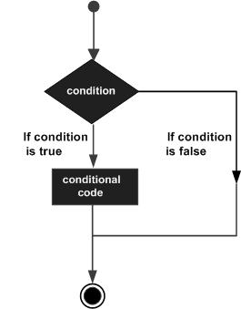
Decision Making

Slide 3
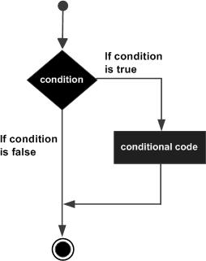
if statement An if statement consists of a boolean expression followed by one or more statements.
#include <stdio.h>
int main ()
{
int a = 10;
if( a < 20 )
{
printf("a is less than 20\n" );
}
printf("value of a is : %d\n", a);
return 0;
}

Slide 4
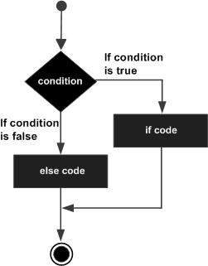
if...else statement An if statement can be followed by an optional else statement, which executes when the Boolean expression is false.
#include <stdio.h>
int main ()
{
int a = 100;
if( a < 20 )
{
printf("a is less than 20\n" );
}
else
{
printf("a is not less than 20\n" );
}
printf("value of a is : %d\n", a);
return 0;
}

Slide 5
nested if statements You can use one if or else if statement inside another if or else ifstatement(s).
#include <stdio.h>
int main ()
{
int a = 100;
int b = 200;
if( a == 100 )
{
if( b == 200 )
{
printf("Value of a is 100 and b is 200\n" );
}
}
printf("Exact value of a is : %d\n", a );
printf("Exact value of b is : %d\n", b );
return 0;
}

Slide 6
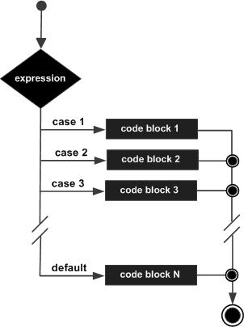
switch statement A switch statement allows a variable to be tested for equality against a list of values.
#include <stdio.h>
int main ()
{
char grade = 'B';
switch(grade)
{
case 'A' :
printf("Excellent!\n" );
break;
case 'B' :
case 'C' :
printf("Well done\n" );
break;
case 'D' :
printf("You passed\n" );
break;
case 'F' :
printf("Better try again\n" );
break;
default :
printf("Invalid grade\n" );
}
printf("Your grade is %c\n", grade );
return 0;
}

Slide 7
nested switch statements You can use one switch statement inside another switch statement(s).
#include <stdio.h>
int main ()
{
int a = 100;
int b = 200;
switch(a)
{
case 100:
printf("This is part of outer switch\n", a );
switch(b)
{
case 200:
printf("This is part of inner switch\n", a );
}
}
printf("Exact value of a is : %d\n", a );
printf("Exact value of b is : %d\n", b );
return 0;
}

